Slide 1

Fundamentals of Deep Learning
www.BigDataTrunk.com

Slide 2
Welcome to
Fundamentals of Deep Learning
PRE-WORK
Sign-in for Attendance
Put Name on Name tag
Download Anaconda (python v3.x)
https://www.anaconda.com/distribution/
Download material from zip in email
or
tinyurl.com/y6cfygqd
www.BigDataTrunk.com

Slide 3
Agenda
01
Machine Learning Overview
02
Neural Networks
03
Python & NumPy
04
TensorFlow
05
Deep Learning and Convolution Neural Networks
06
Next Steps

Slide 4
Introduction
Antony Ross
Data Science and Machine Learning
Sports performance data
Research in music recommendations and voice recognition
Presently working with financial data

Slide 5
Logistics
Timing – 9 to 4 PM PST
Lunch – Approx. noon to 1 PM PST
Periodic Breaks – At logical points

Slide 6
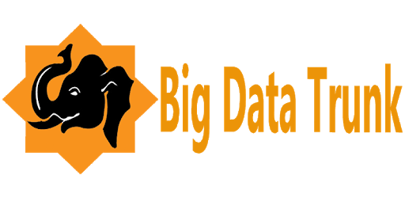

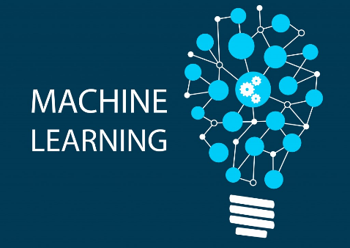

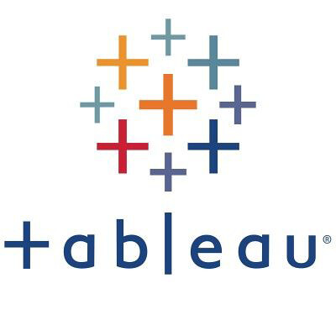

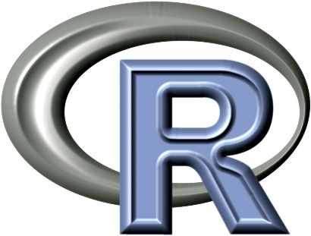
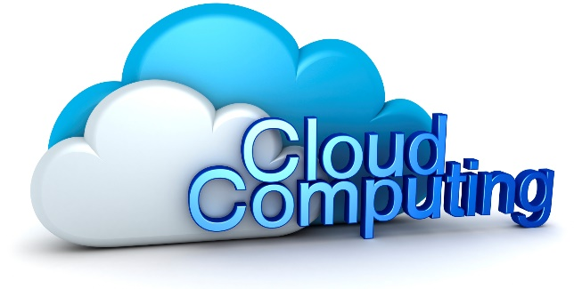
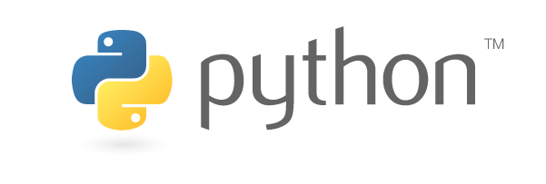
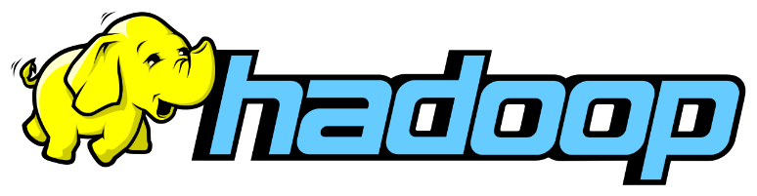

Stanford &

Slide 7
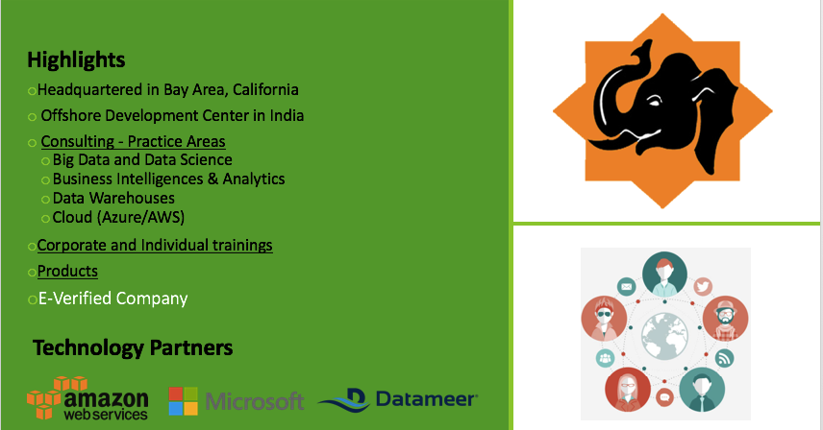
Big Data Trunk

Slide 8
Your turn
Who – Brief background
Why are you here? (Key Motivations)
How are you planning to use this knowledge?

Slide 9
Machine Learning
&
Neural Networks

Slide 10
Hands-on
Jupyter Notebook & Python

Slide 11
Hands-on
NumPy

Slide 12
Hands-on
TensorFlow

Slide 13
Deep Learning
&
Convolutional Neural Networks

Slide 14
Survey Time
http://ttseval.stanford.edu

Slide 15
Next steps
Make a custom plan for yourself to continue this journey
Improve some of your skills (Python, ML, DL, Domain, etc.)
Take some additional courses
Try a Kaggle.com competition
Work on a personal project to improve understanding

Slide 16
Useful Machine Learning and Deep Learning books for beginners to intermediate:
Book | Author
An Introduction to Statistical Learning | Robert Tibshirani and Trevor Hastie John W. Foreman
Python Machine Learning | Sebastian Raschka and Vahid Mirjalili
The Hundred-Page Machine Learning Book | Andriy Burkov
Neural Networks and Deep Learning | Michael Nielsen
Deep Learning | Ian Goodfellow, Yoshua Bengio, and Aaron Courville

Slide 17
Stanford Upcoming Training
Click here for latest schedule

Slide 18
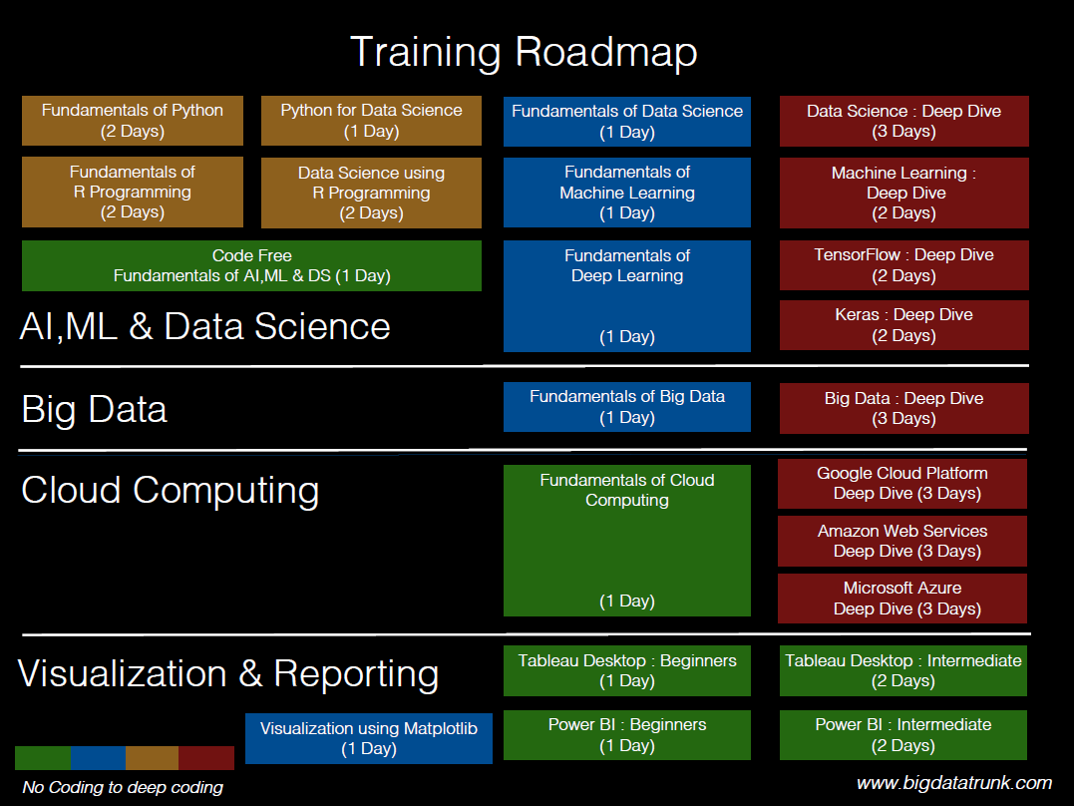

Slide 19
